Slide 1
CAPSTONE PROJECT
Medical Inventory system and infrastructure
Shubham D sable

Slide 2
Objective
To create a better network connectivity and ease of access to the resources.
Cost effective environment.
Smooth working.

Slide 3
Components as per design requirements:
Each department with a single pc (VPC).
Each department with individual network switch (Ethernet switch).
Firewalls (Router).
Router.
Web server.
Database.
NAT Gateway.

Slide 4
IP Implementation
Dept1- 192.168.1.10/24
GW-192.168.1.1
Dept2-192.168.2.10/24
GW-192.168.2.1
Dept3-192.168.3.10/24
GW-192.168.3.1
Web server-192.168.7.10
Database- 192.168.7.20
GW- 192.168.7.1

Slide 5
Services installed
Web server- Apache and SNORT(Intrusion Prevention System).
Database- Mysql & Kerberos server(network authentication protocol).
Client VM- Kerberos client.

Slide 6
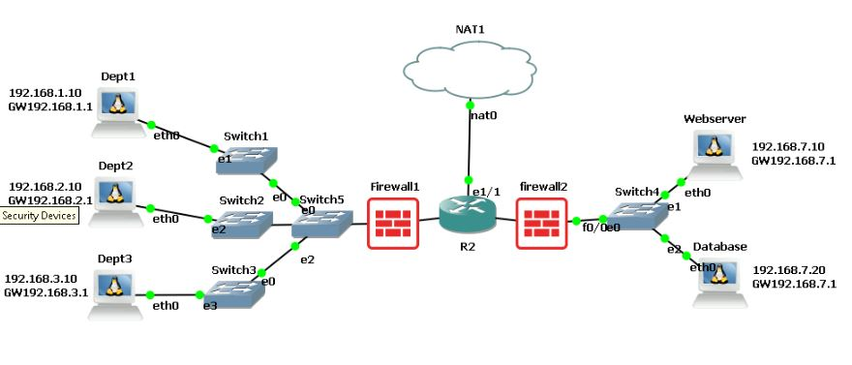
Design

Slide 7
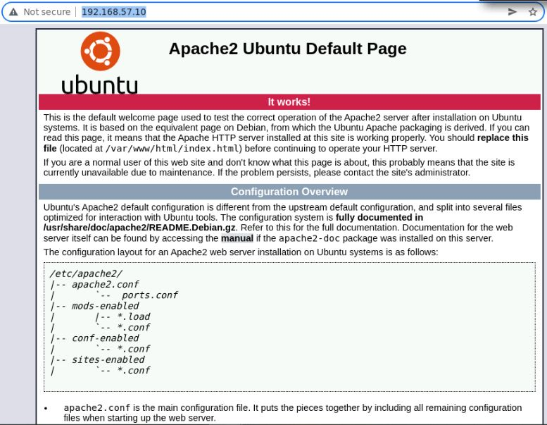
Apache webserver

Slide 8
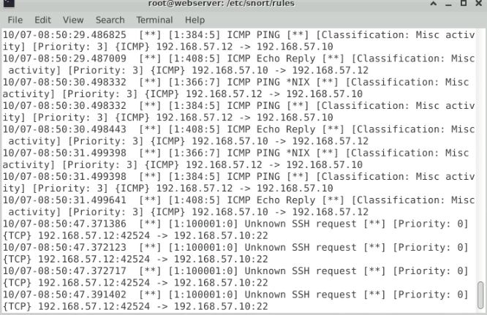
snort

Slide 9
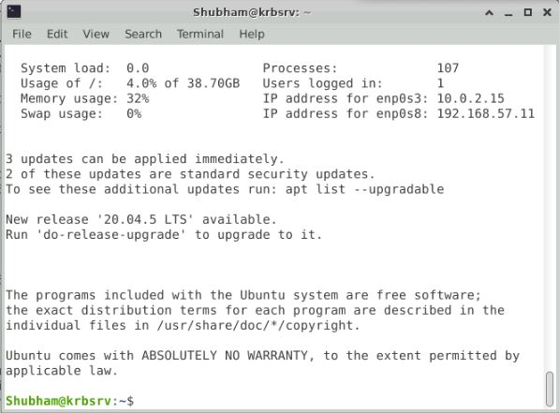
Kerberos

Slide 10
Thank you

